Slide 1



Farmers Market Database Project
ATETE MUHIRE Gretta Varria
26258

Slide 2

1
Introduction
2
Problem Definition
3
Methodology & Approach
Entity-Relationship (ER) Diagram
4
Agenda
5
Key Processes
Results and Use Case Example
6
Benefits and Implementation Overview
6
Conclusion, Recommendations, and Future Work
7
7
References

Slide 3


Introduction
Overview of Project
Automate Inventory and Sales Tracking for Vendors: The system digitizes inventory and sales management, allowing vendors to track stock and transactions seamlessly while minimizing manual entry and errors.
Improve Efficiency and Accuracy: Automation simplifies operations by delivering real-time data and insights, improving decision-making and boosting efficiency for optimal business performance

Slide 4

Problem Definition
Challenges Addressed Below
Key Processes
Inefficient inventory management at farmers' markets.
Lack of accurate sales tracking and reporting.
Need for real-time data access for vendors and managers.
Processes Explained:
Adding new products.
Recording sales.
Checking low stock alerts.
Generating reports for market managers

Slide 5

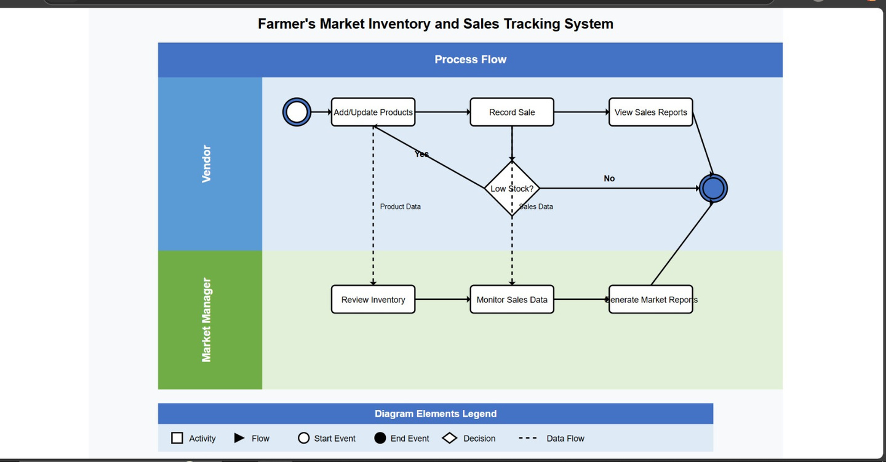
Methodology & Approach
Business Process Modelling
Swimlane Diagram: Illustrates vendor and manager interactions.
Insert Swimlane Diagram:
Swimlane Diagram

Slide 6
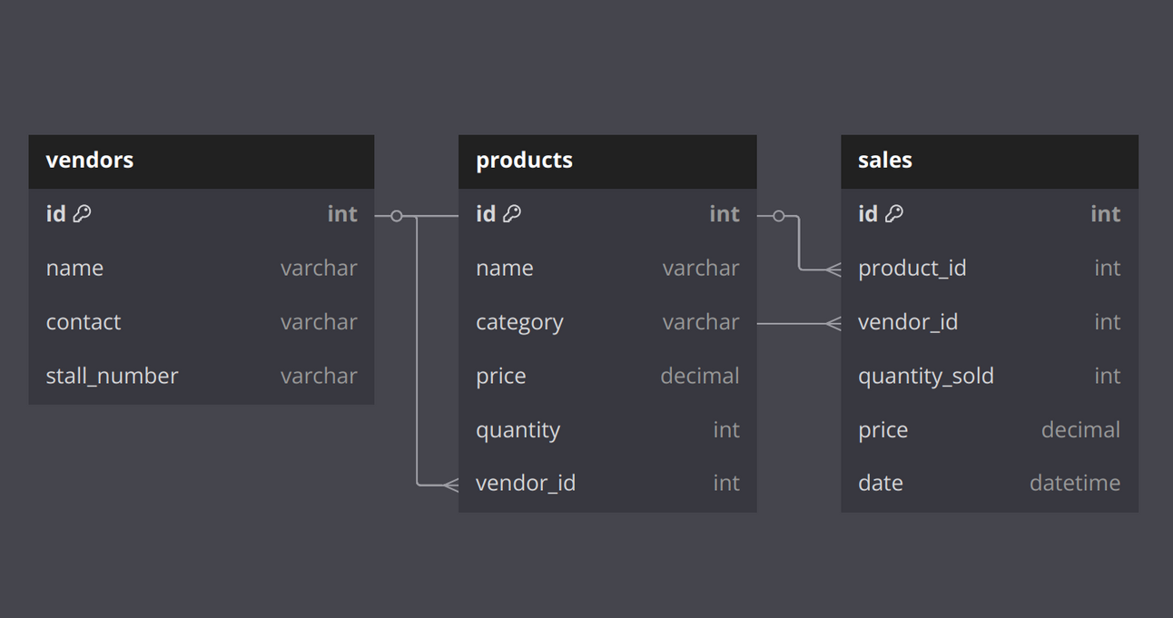
Entity-Relationship (ER) Diagram
Key Entities
Overview
•Vendors: Manage product
listings and sales.
•Products: Inventory details.
•Sales: Track sales transactions.

Slide 7
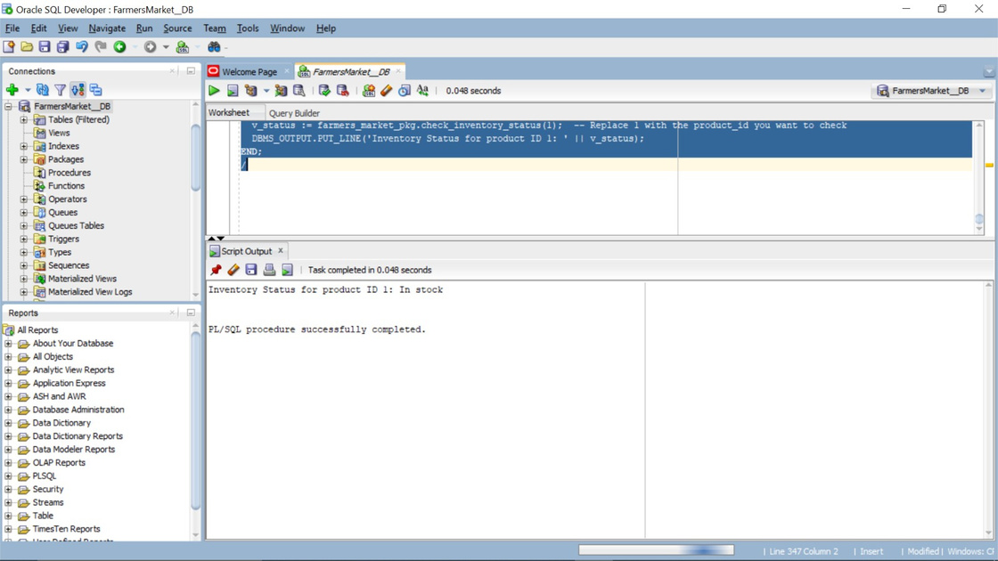
Results and Use Case Example
Explanation:
The command retrieves the inventory status of a product using a package called farmers_market_pkg.
The variable v_status stores the result.
The output shows that product ID 1 is "In stock", indicating there is available inventory.
Database Functionality Real-time inventory management and low-stock alerts.

Slide 8

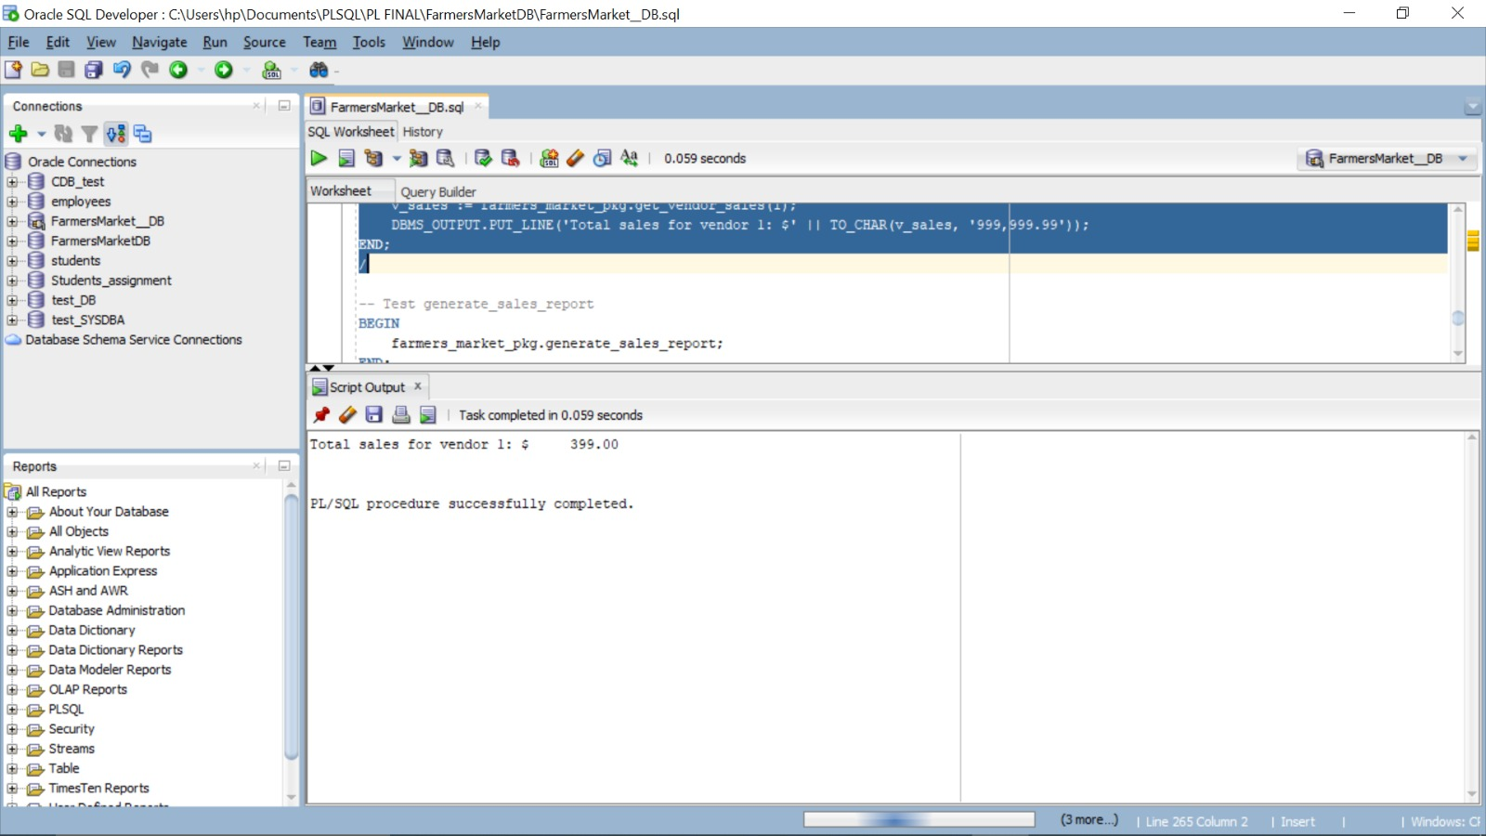
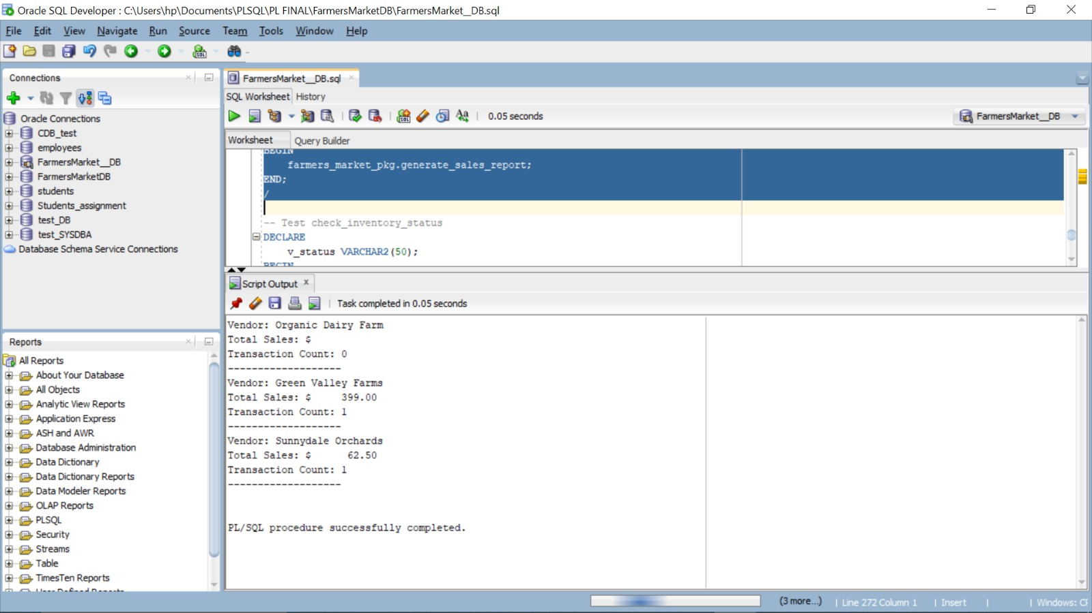
Results and Use Case Example
Vendor 1:
procedure farmers_market_pkg.generate_sales_report retrieves sales data for vendors from the database.
It calculates the total sales for vendor 1 and formats the result as currency using TO_CHAR. The result, $399.00, is displayed via DBMS_OUTPUT.PUT_LINE in the script output
The procedure farmers_market_pkg.generate_sales_report retrieves sales data from the FarmersMarket_DB database, likely from tables storing vendor transactions.
It calculates the total sales and transaction counts for each vendor, formatting the results (e.g., $399.00 for Green Valley Farms) using TO_CHAR. The output is displayed via DBMS_OUTPUT.PUT_LINE, showing sales and transaction details for each vendor in the script output.

Slide 9
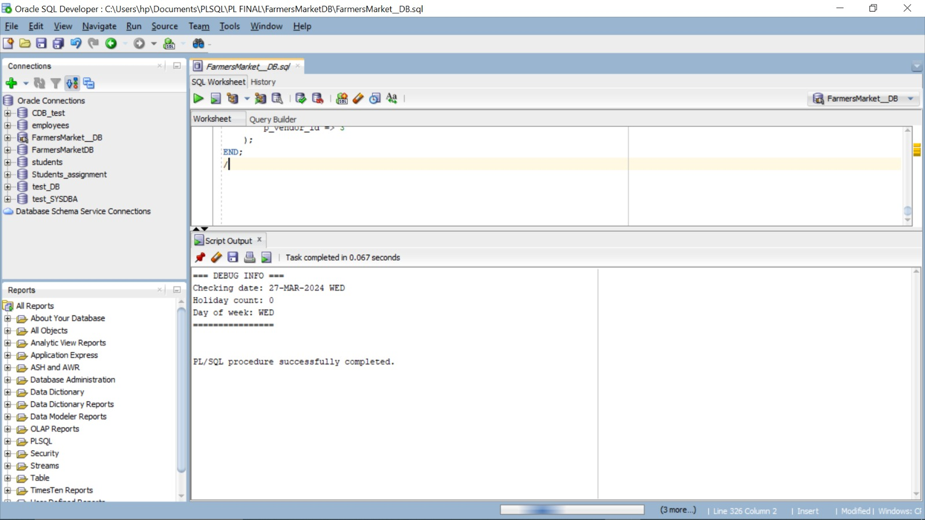
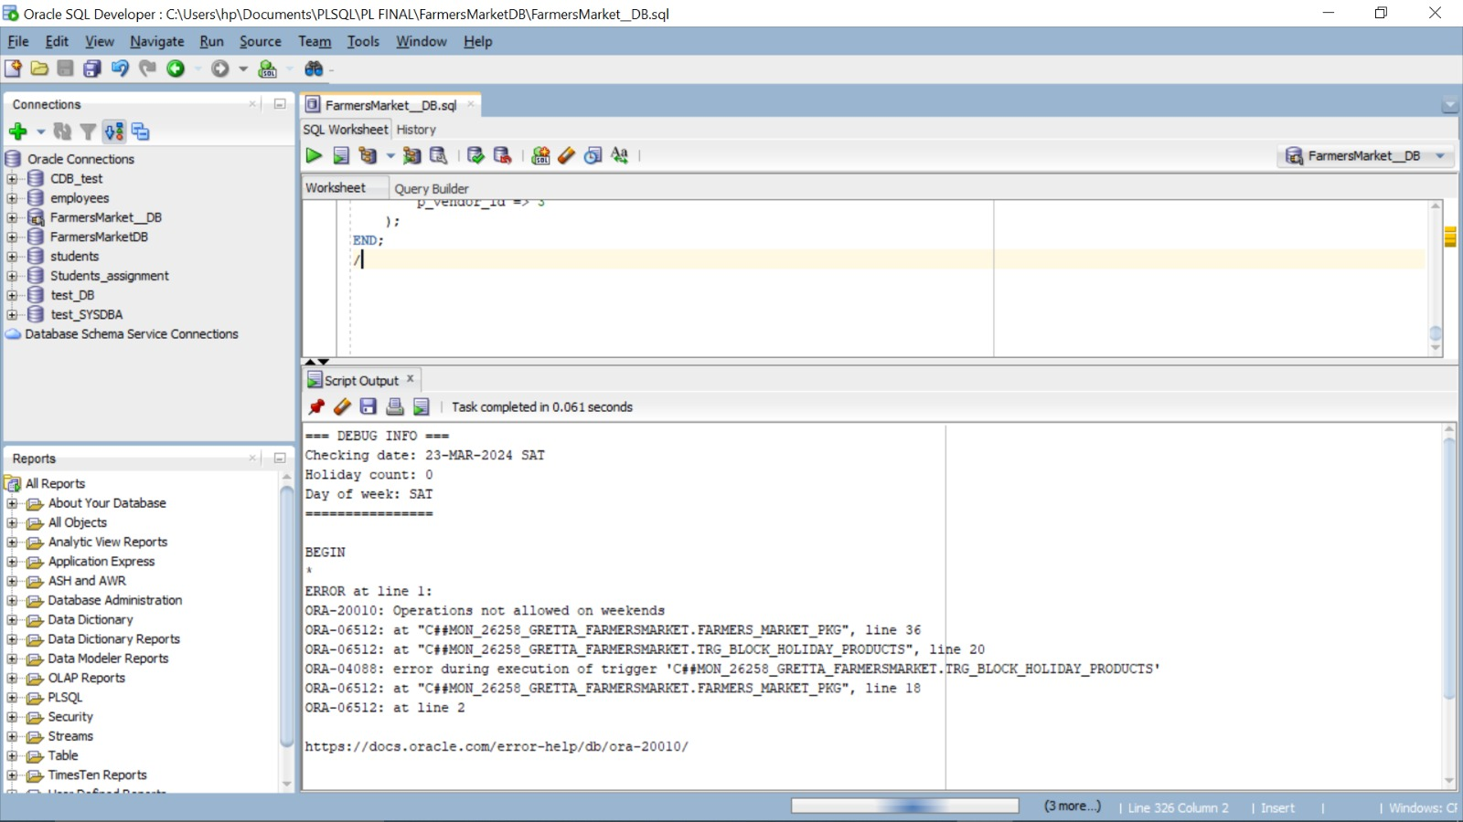
Results and Use Case Example
In Regular Days:
The farmers_market_pkg.check_inventory_status procedure queries the FarmersMarket_DB to check inventory status for a specific date.
It determines if the date (27-Mar-2024, a Wednesday) is a holiday and counts related weeks, finding no holidays and 0 weeks. The results are output via DBMS_OUTPUT.PUT_LINE, showing the date, day, holiday count, and weeks, completing in 0.067 seconds.
This Oracle SQL trigger (TRG_BLOCK_HOLIDAY_PRODUCTS) is part of the FARMERS_MARKET_PKG package. It is designed to prevent database operations (like insert, update, or delete) on weekends or holidays.
When a user tries to perform an operation on a restricted day—such as Saturday (23-MAR-2024 in this case)—the trigger executes, checks the day, and raises a custom error (ORA-20010) to block the operation, ensuring data integrity according to business rules.

Slide 10

Implementation Overview and Conclusion
Implementation Details:
Data Storage: Oracle Database for robust data management.
Business Logic: PL/SQL for sales calculations and inventory updates.
User Interface: User-friendly interface for vendors and market managers.
Summary:
Prevents stockouts and tracks sales history effectively.
Simplifies vendor management with accurate, real-time reporting.
Enhances decision-making through automated inventory and sales insights.

Slide 11

Recommendations, Future Work, and References
Recommendations:
Incorporate advanced analytics for deeper sales and inventory insights.
Provide user training to ensure effective system adoption.
Future Work:
Expand system to support multiple markets or online platforms.
Integrate mobile app support for real-time vendor access.
References:
Business Process Model and Notation (BPMN) standards: https://bpmn.io/
Oracle Database documentation for SQL and PL/SQL: https://docs.oracle.com/en/database/oracle/oracle-database/19/sqlrf/index.html
Articles on inventory management best practices: https://www.netsuite.com/portal/resource/articles/inventory-management/what-are-inventory-management-controls.shtml

